Slide 1
Pathways to Commercial Liftoff Virtual Power Plants Update
January 2025

Slide 2
Since the VPP Liftoff Report was published in September 2023, the near-term pressures on the U.S. electric grid have intensified
Reliability
Rapid electricity demand growth
Affordability
Upward pressure on customer costs from growing capital investments
Resilience
Increasingly frequent extreme weather events

Slide 3
Reliability: Peak demand is growing faster than anticipated; projections show peak rising by ~100 GW between 2024 and 2030
U.S. summer peak hour demand by year (2023-2030), GW
900
2024 Projection
890
880
870
860
850
2023 Projection
840
830
2022 Projection
820
810
800
0
Source: NERC 2024 Electricity Supply and Demand data

Slide 4
Affordability: Growth in distribution system costs outpaces all other grid capital costs
Annual U.S. capital expenditures by sector (2003-2023), billions of 2023 U.S. dollars ($)
55
50
Distribution
45
40
35
30
Transmission
25
Generation
20
15
Other
10
5
0
Source: FERC Form 1 (Electric Utility Annual Report)

Slide 5
Resilience: The number of billion-dollar climate and weather events has doubled over the last 10 years
Number of billion-dollar climate and weather events, count / year (adjusted for inflation)
2000
2001
2002
2003
2004
2005
2006
2007
2008
2009
2010
2011
2012
2013
2014
2015
2016
2017
2018
2019
2020
2021
2022
2023
2024 YTD (as of Oct)
Source: NOAA Billion-Dollar Weather and Climate Disasters

Slide 6
Against the backdrop of these challenges, VPPs are among the critical solutions that can ensure a reliable, affordable, resilient grid
Quick to deploy
Basic VPPs can be launched in less than 6 months
Low-cost
VPP peaking capacity is 40% cheaper than a traditional power plant
Resilient
Solar with batteries and / or fuel generator VPPs can provide backup power during emergencies

Slide 7
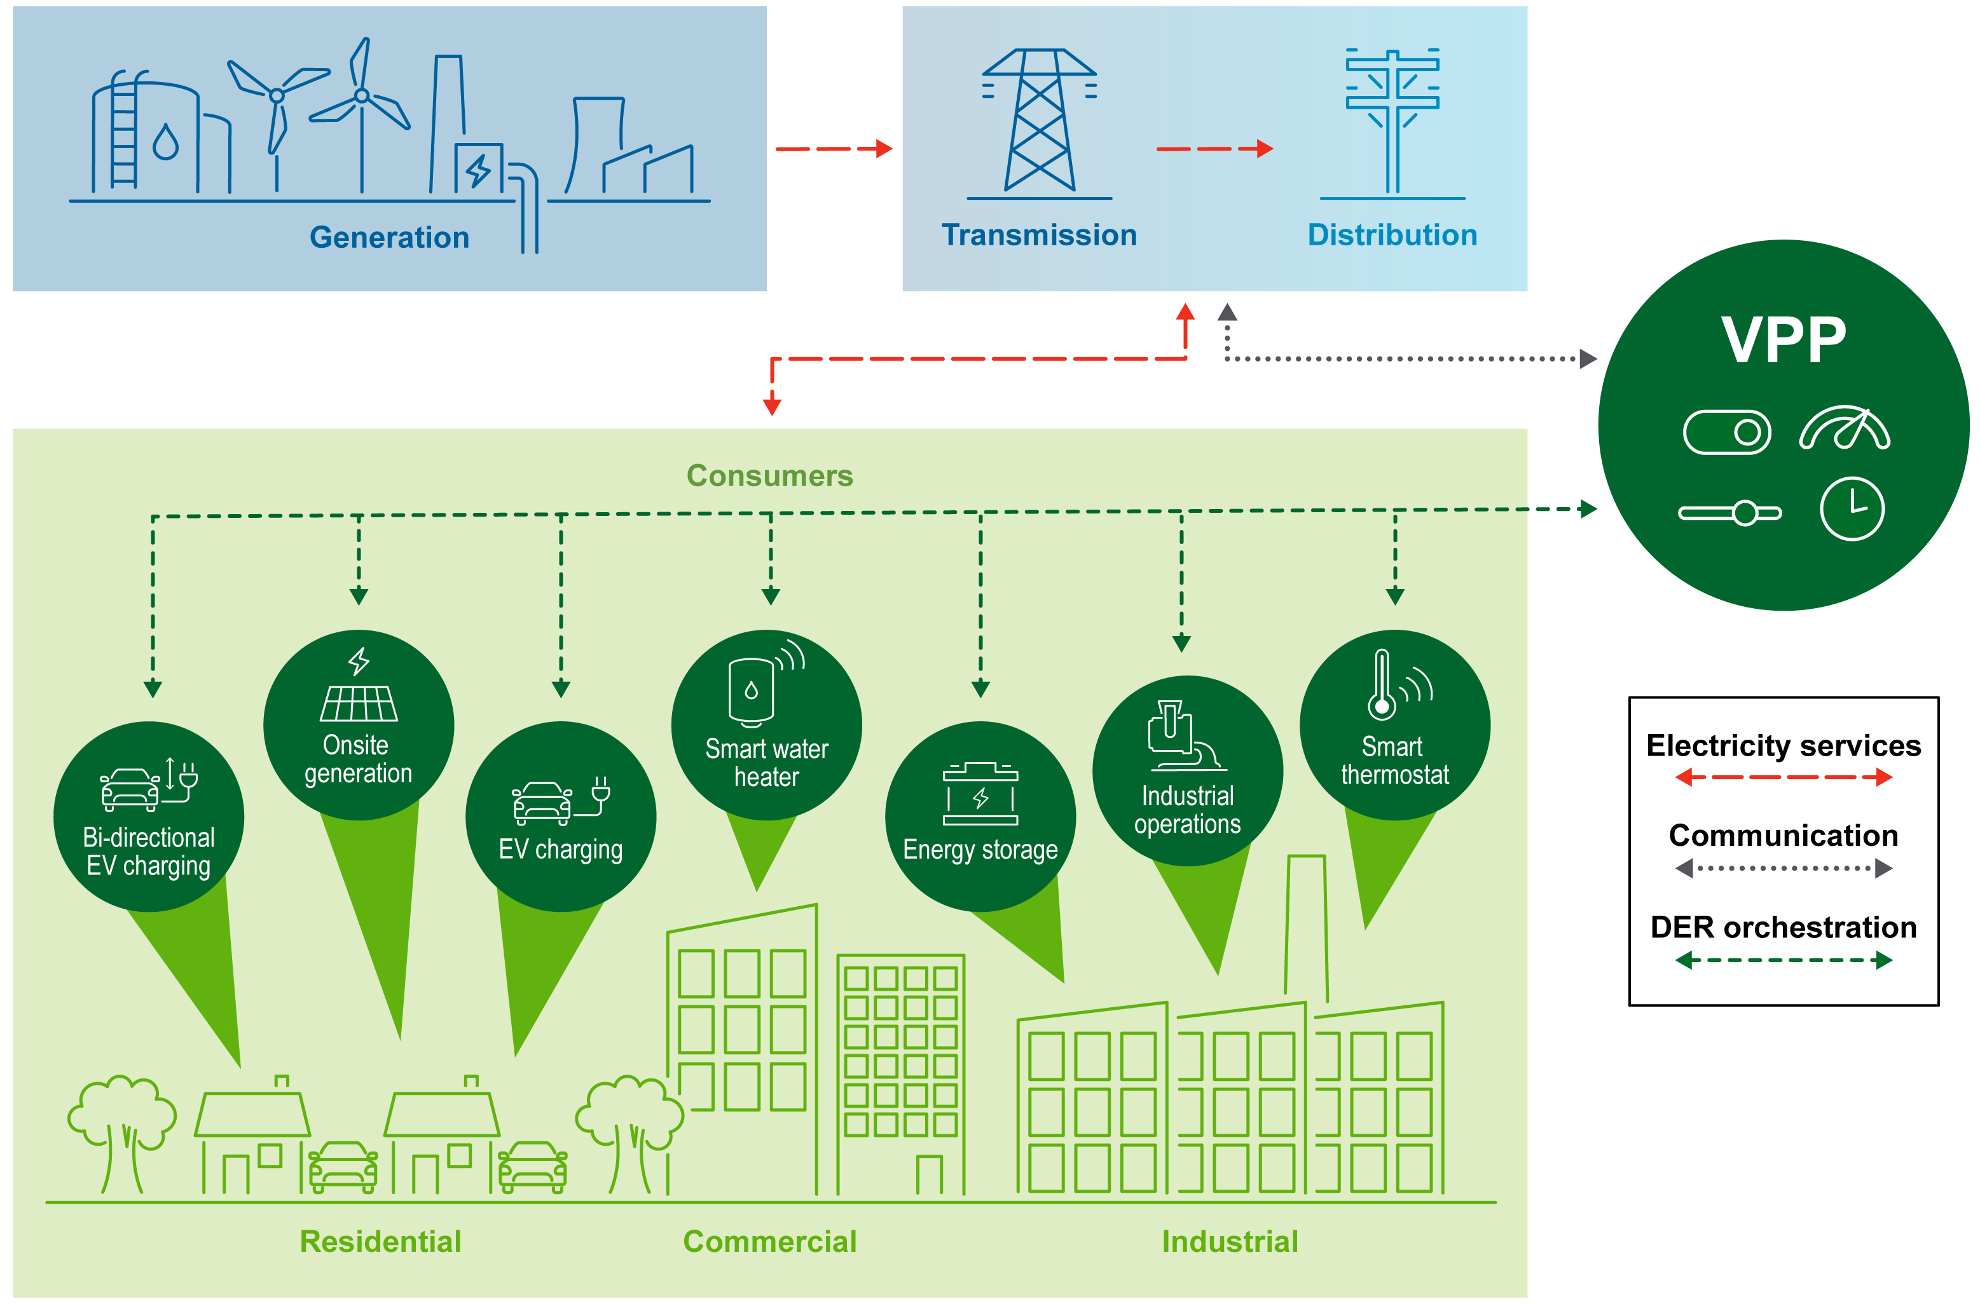
Recall: What is a virtual power plant (VPP)?
Reference the 2023 VPP Liftoff Report for additional background

Slide 8
Quick to deploy: Basic VPPs that provide valuable peak shaving capabilities can be implemented in less than six months
Timeline to add 20 MW of dispatchable peaking capacity, months
Basic VPP
6-12 months
Utility scale battery
27-50 months
Gas peaker plant
20-60 months
Legend
Time required to add capacity (25th percentile)
Additional time that may be necessary depending on local constraints (75th percentile)
Source: Industry interviews, RMI Reliability Brief, Lawrence-Berkeley National Lab’s 2024 Queued Up Report

Slide 9
Lower-cost: Net cost to a utility of providing resource adequacy from a VPP can be 40% to 60% lower cost vs. alternatives
Comparison of net cost to an example utility of providing 400 MW resource adequacy across three options, Net cost per kW-year
Basic VPP
$43
Utility scale battery
$69
Gas peaker plant
$99
Source: Brattle Group’s Real Reliability: The Value of Virtual Power Report

Slide 10
Deploying 80-160 GW of VPPs by 2030 (enough to serve 10-20% of peak load) could support rapid load growth while reducing overall grid costs
VPP liftoff
US Peak electricity demand
~200 GW peak demand needs
~900 GW
80-160 GW VPPs by 2030
10-20% of peak
~3-5x current scale
~800 GW
~30 GW VPPs
~100 GW potential retirements
2024 Current state
2030 VPP Liftoff
Peak demand served by VPPs
Peak demand served by retiring resources
Peak demand served by non-VPP resources
New resources needed to meet peak demand
Source: NERC 2024 Long-Term Reliability Assessment, NERC 2024 Electricity Supply & Demand data, Wood Mackenzie 2024 NA VPP Market Report

Slide 11
Recall: Five imperatives will accelerate Liftoff for VPPs
1
2
Expand DER adoption with equitable benefits
Simplify VPP enrollment
3
Increase standardization in VPP operations
4
5
Integrate into utility planning and incentives
Integrate into wholesale markets

Slide 12
Expand DER adoption with equitable benefits
Simplify VPP enrollment
Increase standardization in VPP operations
Integrate into utility planning and incentives
Integrate into wholesale markets

Slide 13
Example in action: Solar Battery Savings program
Case study: San Diego Community Power, CA
San Diego Community Power leverages upfront, stackable incentives to provide the opportunity for no-cost solar and batteries to qualified priority populations
The program was designed to benefit all customers through upfront incentives for solar and batteries | Community Power worked with state and local programs to ensure their incentives could stack with other programs

Slide 14
Expand DER adoption with equitable benefits
Simplify VPP enrollment
Increase standardization in VPP operations
Integrate into utility planning and incentives
Integrate into wholesale markets

Slide 15
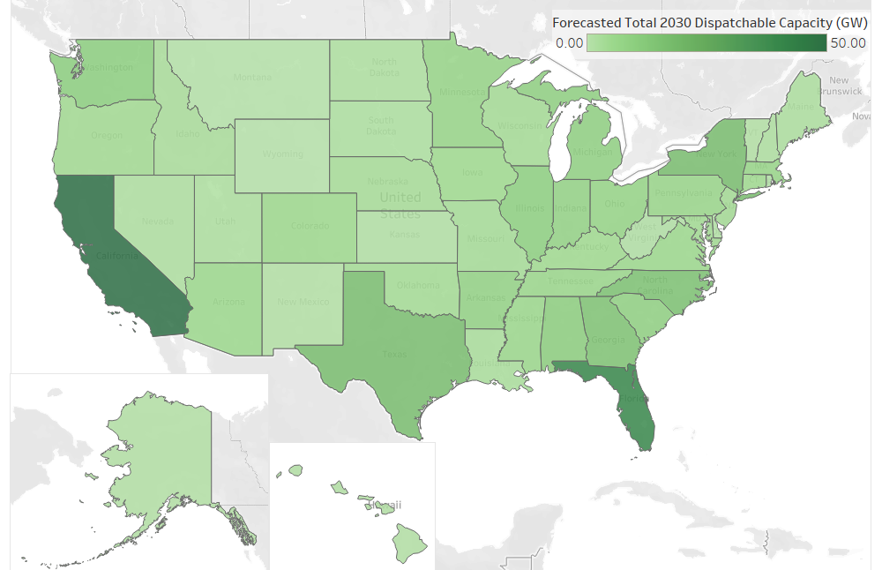
DER capacity is expected to grow in every state across the U.S., though the magnitude of growth and the types of DERs that come online will vary
2030 total dispatchable capacity, GW
California is estimated to have over 50 GW of dispatchable capacity by 2030, spread out across all DER types. EV chargers, fuel generators, and batteries comprise the majority.
Maine is estimated to have over 2 GW of dispatchable capacity by 2030, with ~50% coming from fuel generators and the remaining from EV chargers, heat pumps, and smart thermostats.
Texas is estimated to have 16.5 GW of dispatchable capacity by 2030, a third of which comes from EV chargers. The remaining comes primarily from C&I loads, smart thermostats, and heat pumps.
Source: Ohm Analytics State-Level Residential DER Capacity Forecast, Wood Mackenzie 2024 US DER Market Report, National Renewable Energy Lab The 2030 National Charging Network Report, EIA 2022 Meter Data, DOE analysis

Slide 16
10-20% of peak demand could be served by VPPs with baseline forecasts of DER adoption and demonstrated best-in-class VPP enrollment rates
Enrollment rate assumed |  | ~15% | ~30% | ~60%-90%
~30-65
~80-160 GW
~50
~30
~25
~30 GW
~25
2024 VPP capacity
Current VPP enrollment rate
No-regrets enrollment practices
Proven high-impact enrollment practices
2030 VPP capacity
Assumptions |  | ~15% of dispatchable capacity additions only | ~15% uplift from improved messaging, flexibility, and customer value proposition | ~30% uplift from point-of-purchase enrollment; additional upside from automatic enrollments with opt-outs
Source: DOE analysis

Slide 17
Expand DER adoption with equitable benefits
Simplify VPP enrollment
Increase standardization in VPP operations
Integrate into utility planning and incentives
Integrate into wholesale markets

Slide 18
In the past year, DOE and other industry actors have launched or expanded efforts to standardize critical areas of VPP operations
Distribution system operators
Focus area of recent standardization efforts | Example initiatives (not exhaustive)
VPP platform to utility communication interface | FlexIT
Grid services definitions | DOE Distribution System Transformation
Aggregator service contracts | NAESB standard services contract
VPP platform to DER communication interface | Mercury Consortium
Meter data format and access rules | Green Button Standard
VPP resource definition | IEEE VPP Guide
Shared DER registry | CULSN DER registry model
Cybersecurity for DERs | DER Cybersecurity Best Practices
1
2
VPP platforms
3
4
5
6
7
Customer DERs
8

Slide 19
Expand DER adoption with equitable benefits
Simplify VPP enrollment
Increase standardization in VPP operations
Integrate into utility planning and incentives
Integrate into wholesale markets

Slide 20
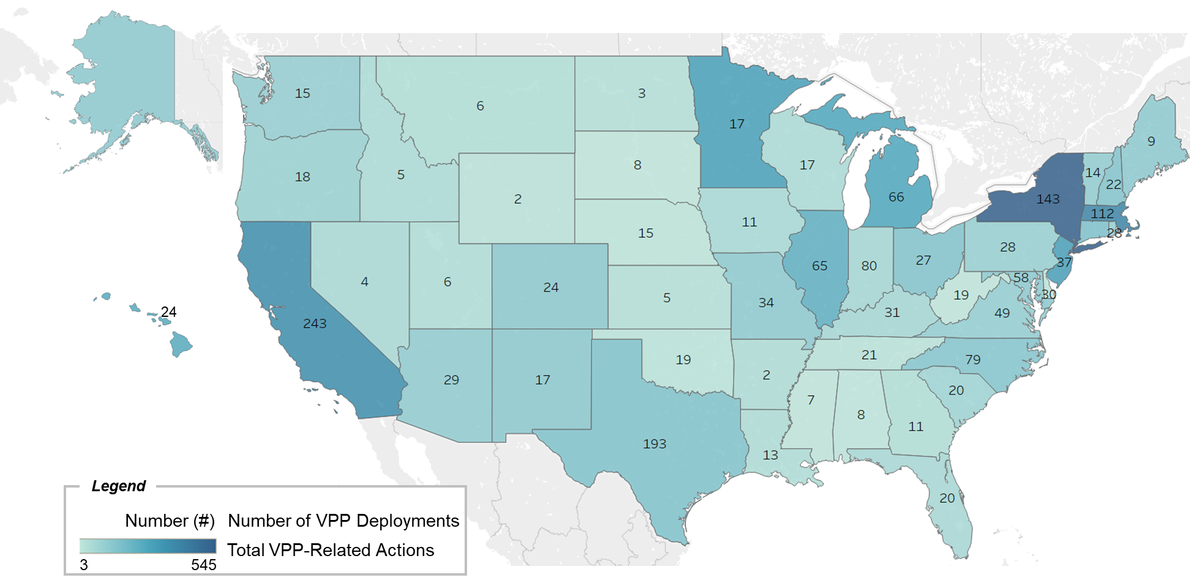
VPP deployment has been highest in states where state regulators and policymakers have implemented VPP-supportive actions
Number of VPP deployments vs state policy/regulatory VPP-related actions (2020-Q3 2024), count
Source: Wood Mackenzie 2024 NA VPP Market Report, North Carolina Clean Energy Technology Center Policy & Regulatory Actions

Slide 21
Expand DER adoption with equitable benefits
Simplify VPP enrollment
Increase standardization in VPP operations
Integrate into utility planning and incentives
Integrate into wholesale markets

Slide 22
ISO/RTO compliance with FERC Order 2222 requirements has been varied: CAISO, NYISO, and ISO-NE are leading implementation
Issue Areas | CAISO | ISO-NE | NYISO | PJM | MISO | SPP
Metering and Telemetry System Requirements
Participation Model
Double Counting of Services
Locational Requirements
Role of Distribution Company
Ongoing Operational Coordination
Small Utility Opt-in
Interconnection
Definitions of DER and DER Aggregator
Types of Technologies
Allow a DER to serve as its own aggregator
Min and Max Size of Aggregation
Min and Max Size for DER in an Aggregation
Distribution Factors and Bidding Parameters
Information and Data Requirements
Role of RERRA
Modifications to List of Resources in Aggregation
Market Participation Agreements
Demand response opt-out
Source: Lawrence Berkeley National Lab DER Participation in Wholesale Markets Report, FERC filings

Slide 23
Five imperatives will accelerate Liftoff for VPPs
1
2
Expand DER adoption with equitable benefits
Simplify VPP enrollment
3
Increase standardization in VPP operations
4
5
Integrate into utility planning and incentives
Integrate into wholesale markets
Adopting and adapting demonstrated best practices and leveraging existing tools and resources can accelerate deployment to address near-term grid needs

Slide 24
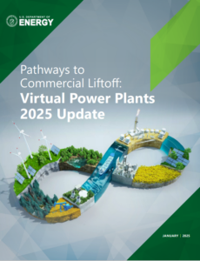
Thank you!
The 2025 VPP Liftoff Update can be found at liftoff.energy.gov/vpp
Feedback is welcome at liftoff@hq.energy.gov
Link to the report!
75+ real-world case studies
60+ new DOE and industry resources

