Slide 1




Pathways to Commercial Liftoff:
Dr. Becca Jones-Albertus, Acting Deputy Assistant Secretary for Renewable Power
Office of Energy Efficiency & Renewable Energy
Moderator
Dr. Vanessa Chan, Chief Commercialization Officer & Director
Office of Technology Transitions
Next-Generation Geothermal Power Fireside Chat
Kelly Cummins, Acting Director & Principal Deputy Director
Office of Clean Energy Demonstrations
Jigar Shah, Director
Loan Programs Office

Slide 2


Pathways to Commercial Liftoff:
Dr. Charles Gertler, Senior Consultant
Loan Programs Office
Report lead author
Next-Generation Geothermal Power Report Overview
Dr. Mike O’Connor, Strategist
Office of Clean Energy Demonstrations
Report lead author

Slide 3

Top-Line Messages
Next-generation geothermal is poised to be a key contributor to a secure, domestic, decarbonized power generation in the US.
Emerging technology vastly expands the total resource available for geothermal power generation
Significant and unique starting advantages: transferrable technology, supply chains, and workforces from the oil & gas sector
Industry is on track to the Enhanced Geothermal Shot target (national average LCOE of $45/MWh by 2035).
Deployment could reach 90+ GW by 2050, and potentially up to 300GW
Achieving liftoff will require 2-5 GW across 4-6 states and $20-25B of investment by 2030
Achieving scale requires an additional 90-130GW of deployment $225-250 billion in investment by 2050
5 challenges to achieve liftoff and scale (potential solutions offered in report):
High up-front costs & risks constraining development capital and limiting geographic reach
Perceived & actual operability risk for deployments
Long and unpredictable development lifecycles driven by permitting and interconnection
Existing business models undervaluing the potential of next-generation geothermal
Community opposition in some instances
Notes:
PART 1: CHARLES // PART 2: MIKE
Read the slide
Pass to Sean for overview & value prop

Slide 4
Chapter 1: Overview & Value Propositions
Next-generation geothermal technologies create their own reservoirs from ubiquitous hot rock, which expands the availability of geothermal resources in the United States from 40 GW to over 5,000 GW.
Next-generation geothermal can economically provide 90 GW of the 700 – 900 GW of clean, firm power needed for a decarbonized economy by 2050, and technical and market factors such as limited land available for other renewables and the rate that other key technologies develop can triple expected deployment to over 300 GW.
Rapidly increasing projections of electricity demand are driving increased need for clean firm power, which already commands a price premium in some cases; PPAs today are signed between $70-100/MWh, $20-50/MWh more than the average solar PPA in North America.
Next-generation geothermal technologies can store energy in the subsurface over long durations, increasing the value proposition of the technology. The economic deployment of next-generation geothermal doubles if this capacity is pursued.
The next-generation geothermal industry can leverage large and existing workforces and supply chains, reducing key commercial and political adoption barriers to, enable faster uptake.

Slide 5
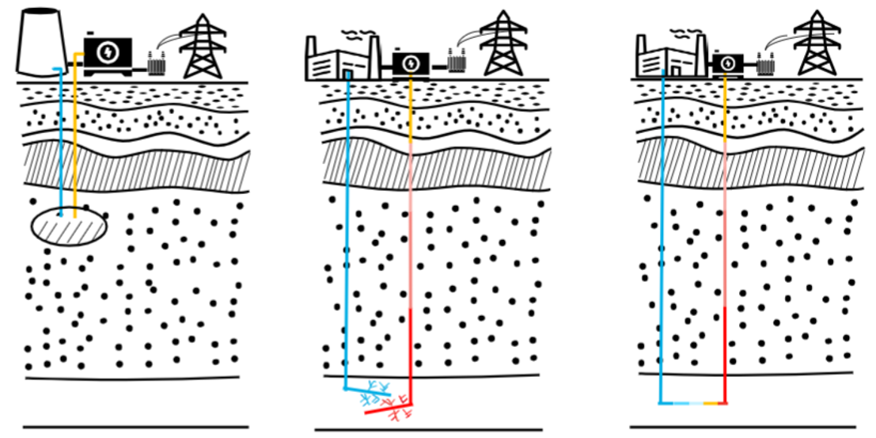
Next-generation geothermal technologies engineer their own resources
Conventional
Next-Generation
Hydrothermal
Enhanced Geothermal Systems (EGS)
Closed Loop Geothermal Systems
Fluids circulate openly through naturally occurring fractures
Limited estimated total resource (~40 GW)
~4 GW on the grid today
Fluids circulate openly within a well pair connected by fractures engineered with hydraulic fracturing & horizontal drilling
Large estimated total resource
(5+ TW all next-generation geothermal)
Scales through modular deployment of many well pairs
Fluids circulate through a long series of closed wellbore loops permeating the subsurface
Large estimated total resource
(5+ TW all next-generation geothermal)
Scales through modular deployment and increasing wellbore lengths
Notes:
Conventional geothermal energy (left panel) has historically only been used for power in niche geologic environments.
However, “next-generation” technologies (right panels) have the potential to engineer effective geothermal resources in commonly-found environments, vastly expanding their potential.
Enhanced geothermal systems (EGS) uses existing drilling and hydraulic fracturing technology developed for unconventional oil & gas recovery, albeit in new and hotter environments.
Closed loop geothermal systems circulate fluids entirely within boreholes closed to the environment. As opposed to EGS, which benefits from having many fracture pathways and thus substantial surface area to allow circulating fluid to conduct heat from hot rock, closed loop systems have only the surface area created by the drilled borehole conveying the fluid. Therefore, to conduct a similar amount of heat, closed loop systems must permeate into deeper, hotter rock, which allows for more intense heat conduction

Slide 6
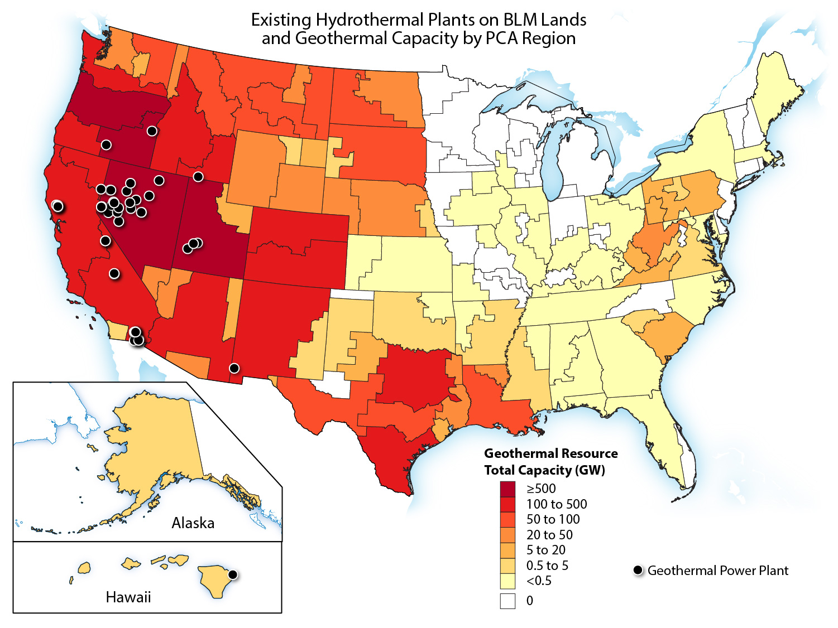
Next-generation technologies dramatically expand available geothermal resources
Next-generation and conventional geothermal resource estimates
GW per region
Notes:
SEAN
Gamechanger not only for the American West, but for the entire nation
No longer is it a resource potential challenge; rather, it’s an engineering opportunity
Size of the prize: over 5,000 GW
There’s a compelling story not just in NV and CA, but also in PA, SC, WV

Slide 7

Next-generation geothermal has a strong and varied value proposition that position it to be a key technology for a decarbonized grid
Next-generation geothermal value proposition
Secure supply chain
Broad geographic availability
Clean
Local permanent jobs
No additional energy required
Firm
Large existing workforce
Flexible
No fuel costs
Minimal footprint
High growth potential
Low transmission buildout
Notes:
SEAN
Lots of reasons why this is a valuable technology
We’ll dive into a couple in the report (clean firm, jobs/workforce, broad geographic availability, high growth potential)
New for this report:
Flexibility in storage
Broad geographic availability

Slide 8
Firm clean power demand is large and increasing
Projected range of additional need for clean firm power in multiple net-zero scenarios from 2023 to 2050
Total peak summer demand change expected from 2023 to 2028, % change from 2023
2023-2028
growth (GW):
11 GW
7 GW
4 GW
1 GW
1 GW
1.9 GW
3 GW
1 GW
Notes: Figure adapted from 2023 National Load Growth Report. Puget Sound Energy: Puget Sound Energy Demand Forecast CAISO: 2022 Integrated Energy Policy Report Update Arizona Public Service: 2023 Integrated Resource Plan NYISO: 2022 and 2023 Load & Capacity Data Georgia Power: Integrated Resource Plan Duke: Carolina Resource Plan PJM: Energy Transition in PJM ERCOT: 2022 and 2023 Long-Term Load Forecast
Notes:
SEAN
Utilities are being forced to rapidly revise how much energy they think they’ll need for the future
Dark green bars – what they thought they needed in 2028, last year
Light green bars – what they think they’ll need in 2028 now
This adds up to nearly 20 GW of load that we didn’t think we needed to build, in just a year. Doing so renewably will be a massive challenge.
These increases are being driven by big loads that never turn off
Industrial & manufacturing facilities that you’ve announced
Data centers

Slide 9

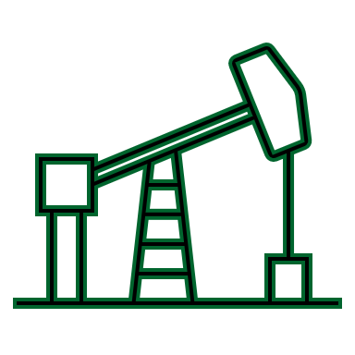


A sufficient existing workforce is a major starting advantage for next-gen geothermal
Existing and anticipated geothermal workforce at scale
Subsurface (geothermal resource)
Surface (power plant)
Development & Operations
Development
Operations
Geoscientists, petroleum engineers, hydrogeologists, other subsurface engineers
Oil field drillers & related service providers
Engineers, project managers, power plant construction workers
Power plant engineers, operators, maintenance, etc.
⁶
⁴
⁷
⁵
Current geothermal workforce¹
Anticipated geothermal workforce at scale²
Current existing workforce with transferrable skills³
Notes: 1. 20% full-time positions -- Green Jobs through Geothermal Development (geo-energy.org); 2. Sum of workforce divisions extracted from USEER 2023 Public Data (see Appendix) 3. Modeled as part of analysis supporting Geothermal: Policies to Help America Lead – Third Way; scaled linearly to represent 90 GW of capacity; 4. Sum of current workforce size reported to the Bureau of Labor Statistics for “Geoscientists”, “Hydrologists”, “Petroleum Engineers”, and “Mining & Geologic Engineers”; 5. Sum of current workforce size reported to the Bureau of Labor Statistics for the following subsets of Oil & Gas Extraction: 47 (Construction), 49 (Installation), 51 (Production), and 53 (Transportation & material moving); 6. Sum of the current workforce size reported to the Bureau of Labor Statistics for the following subsets of Electric Power Generation, Transmission, and Distribution: Architects, Surveyors, and Cartographers; Engineers; Drafters, Engineering Technicians, and Mapping Technicians; Life Scientists; Physical Scientists; Supervisors of Protective Service Workers; Firefighting and Prevention Workers; Other Protective Service Workers; Construction Trades Workers; Other Construction and Related Workers; Extraction Workers; Electrical and Electronic Equipment Mechanics, Installers, and Repairers; Vehicle and Mobile Equipment Mechanics, Installers, and Repairers; Other Installation, Maintenance, and Repair Occupations; Assemblers and Fabricators; Metal Workers and Plastic Workers; Motor Vehicle Operators; Material Moving Workers; 7. Sum of the current workforce size reported to the Bureau of Labor Statistics for the following subsets of “Electric Power Generation, Transmission, and Distribution”: Computer Occupations, Mathematical Science Occupations, Plant and System Operators, Other Production Occupations”
Notes:
SEAN
A workforce of over 300,000 that exists today already possesses the skills and expertise necessary for geothermal power development
The total number of jobs needed for a mature geothermal industry is less than the size of the existing workforce with necessary skills
Geothermal power creates between 3 to 4 times the number of long-term jobs per megawatt as solar and wind
Important to highlight that we’re not trying to teach coal miners to code
61% of the total oil and gas workforce available today is involved in those activities and have skills directly transferrable to geothermal development and operations right now with minimal need for on-the-job retraining

Slide 10
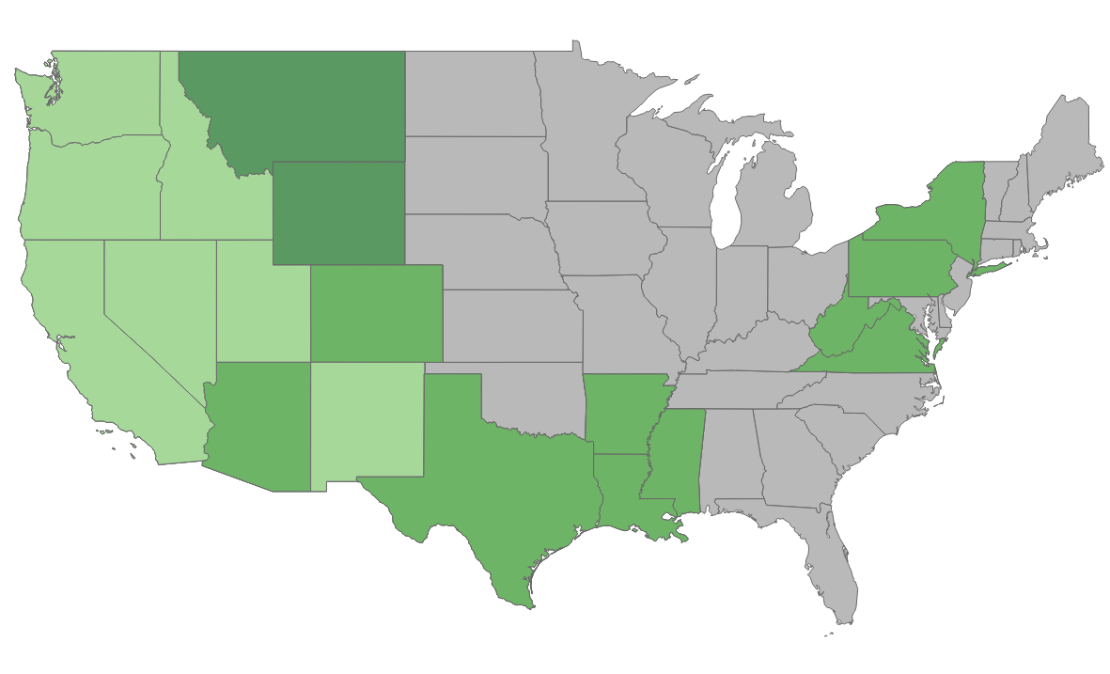
Next-gen geothermal could economically deploy 90-130GW across much of the US by 2050
Estimated next-generation geothermal deployment potential
Potential geographic extent of next-generation geothermal
Cumulative Capacity (Energy Earthshot)
New Capacity Deployed in Period (Energy Earthshot)
Cumulative Capacity (Land Restriction)
New Capacity Deployed in Period (Land Restriction)
2030
2040
2050
Notes:
MIKE
Next-generation geothermal can have 90+ GW on the grid by 2050, and external factors can drive that number up substantially
If it becomes difficult to develop solar & wind due to land use restrictions, geothermal increases to 125 GW
If DAC & H2 struggle to commercialize, 300+ GW
The market reaches the East Coast as early as 2040
Centers in the gulf coast and southwest as well

Slide 11
Long-duration storage capabilities enabled through flexibility increase geothermal value and deployment
Increased 2050 next-generation deployment when flexible generation is enabled
Additional capacity from increased value
Capacity used to flexibly store and release power

Slide 12
Chapter 2: Next-Generation Technology & Market
Despite cost-competitiveness, conventional geothermal project development is constrained by a limited resource base, risk of incorrect resource characterization, inconsistent repeatability, long project lifecycles, and investment perceptions shaped by select project failures.
Next-generation geothermal technologies transfer risk from resource identification to engineering capabilities, creating the potential to sidestep issues that have traditionally held back the geothermal industry.
Iterative improvements enabled by modularity in drilling operations have cut next-generation drilling costs in half over the last year.
DOE’s EGS Energy Earthshot target of $45/MWh is achievable, making EGS cost-competitive with other clean firm energy technologies by 2035.
Recent advances have catalyzed substantial recent momentum in the next-generation geothermal market

Slide 13
Drilling timelines have shown remarkable improvement in 3 years, driving cost reductions
Drilling timelines at DOE FORGE demonstration site
Average drilling times at DOE FORGE demonstration site
Drilling improvements
120-200
FORGE Well, 2017
FORGE Well, Early 2021
FORGE Well, Late 2021
FORGE Well, 2022
Standard oil & gas rates
Notes:
MIKE
So we’ve painted a real rosy picture of what geothermal could be and some of the challenges it can solve. Why do we believe it?
The most compelling reason is around the rapid improvements being made today in geothermal drilling.
LH plot shows the time it took to drill four wells at the Utah FORGE site (time on the x, depth on y). These wells demonstrated a 500% increase in the rate at which these holes were drilled. The average rates for each of these wells are on the right side plot.
We’re going deeper and were going faster than before
Drilling rates are the most important cost driver in geothermal development. Every day you can knock off drilling times is hundreds of thousands in savings. FERVO showed that drilling rate improvements led to cost decreases from $13 million per well to $6 million per well in their most recent pilot.
As exciting as these results are, there’s more to squeeze out of the sponge. Geothermal rates could approach oil and gas rates, which, as you can see, are still by and large faster.

Slide 14
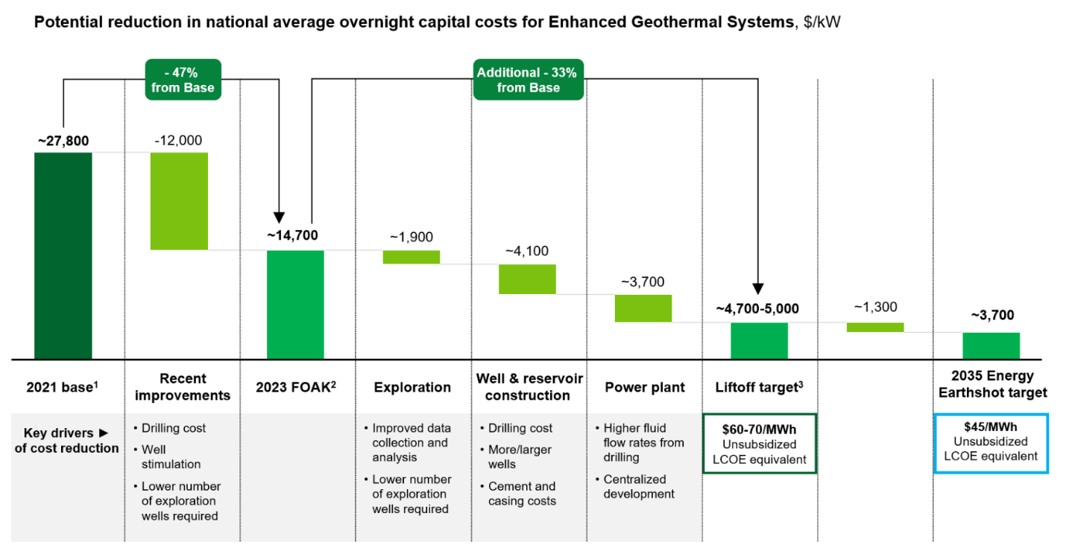
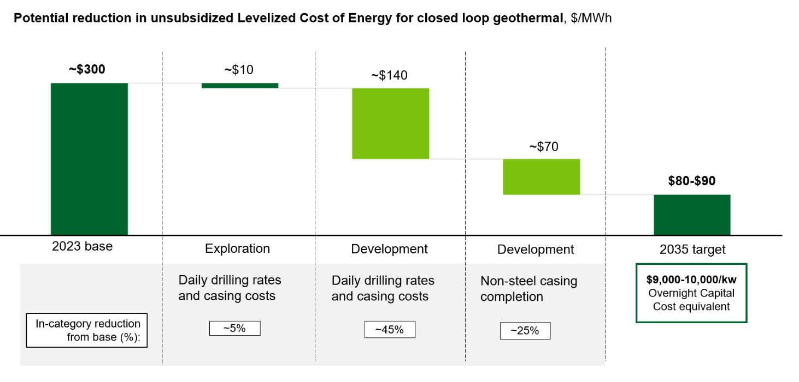
Next-Generation Geothermal costs are on their way to Liftoff and Earthshot targets

Slide 15
Next-generation geothermal market is showing strong recent momentum
Publication Version
Capital raised and cumulative deal count in next-generation geothermal, 2021-2024
Notes: Source: SightLine Climate Geothermal market overview (to cite)

Slide 16
Chapter 3: Pathway to Liftoff
The next-generation geothermal industry is characterized by a combination of unusually high up-front costs, plus a maturation timeline that includes not only reductions in key risk, but also a resource base that increases mainly as new projects are developed
Demonstration in 5-10 separate geologic settings can reduce risk and verify resource availability, catalyzing commercial liftoff in the U.S. by 2030. This corresponds to 100+ developments, 2 to 5 GW of overall deployment, and $20-25B of investment before 2030.
To reach scale by 2050, next-generation geothermal will require an additional $225-250B in investment, driven by a new ecosystem of developers, investors, utilities, and other offtakers, and leveraging existing workforces and supply chains.
RD&D and iteration within drilling and hydraulic fracturing will drive cost reductions as was observed in the oil & gas industry throughout market maturation, and breakthroughs in drilling and resource characterization can further expand potential.
At different market maturities, different development models apply. At low maturity, equity investors dominate, but as maturity increases, a wider array of developer classes leveraging project finance could dominate.

Slide 17
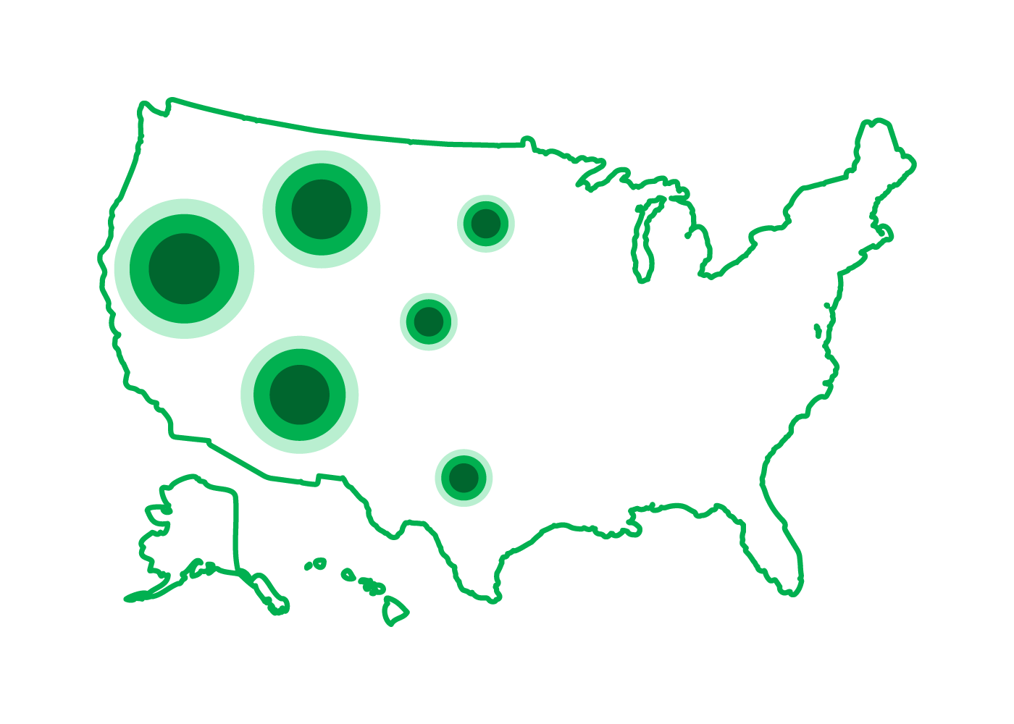
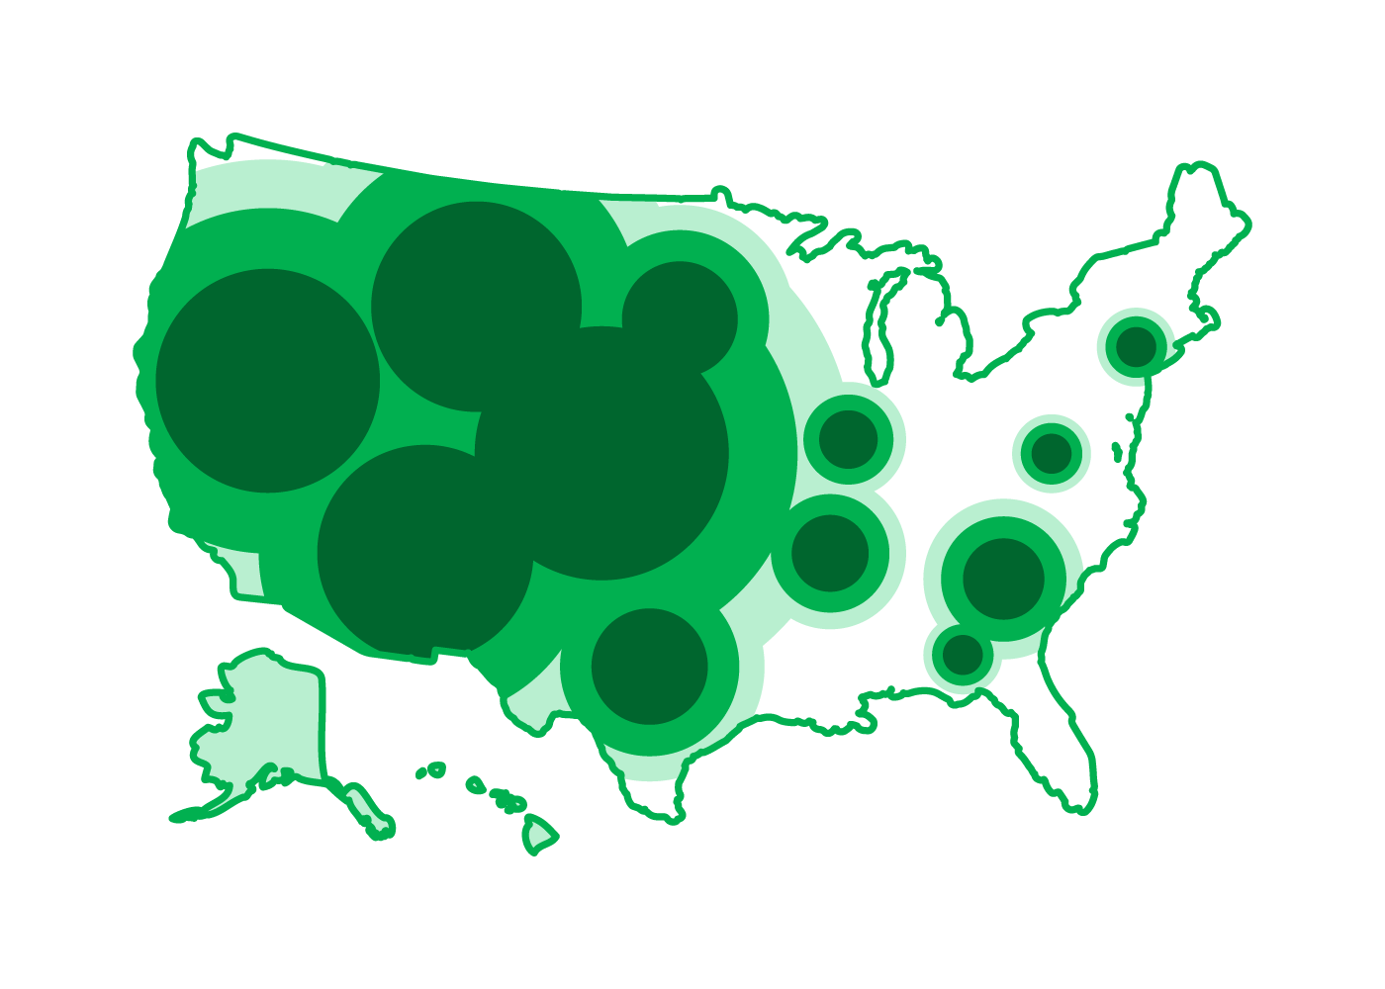
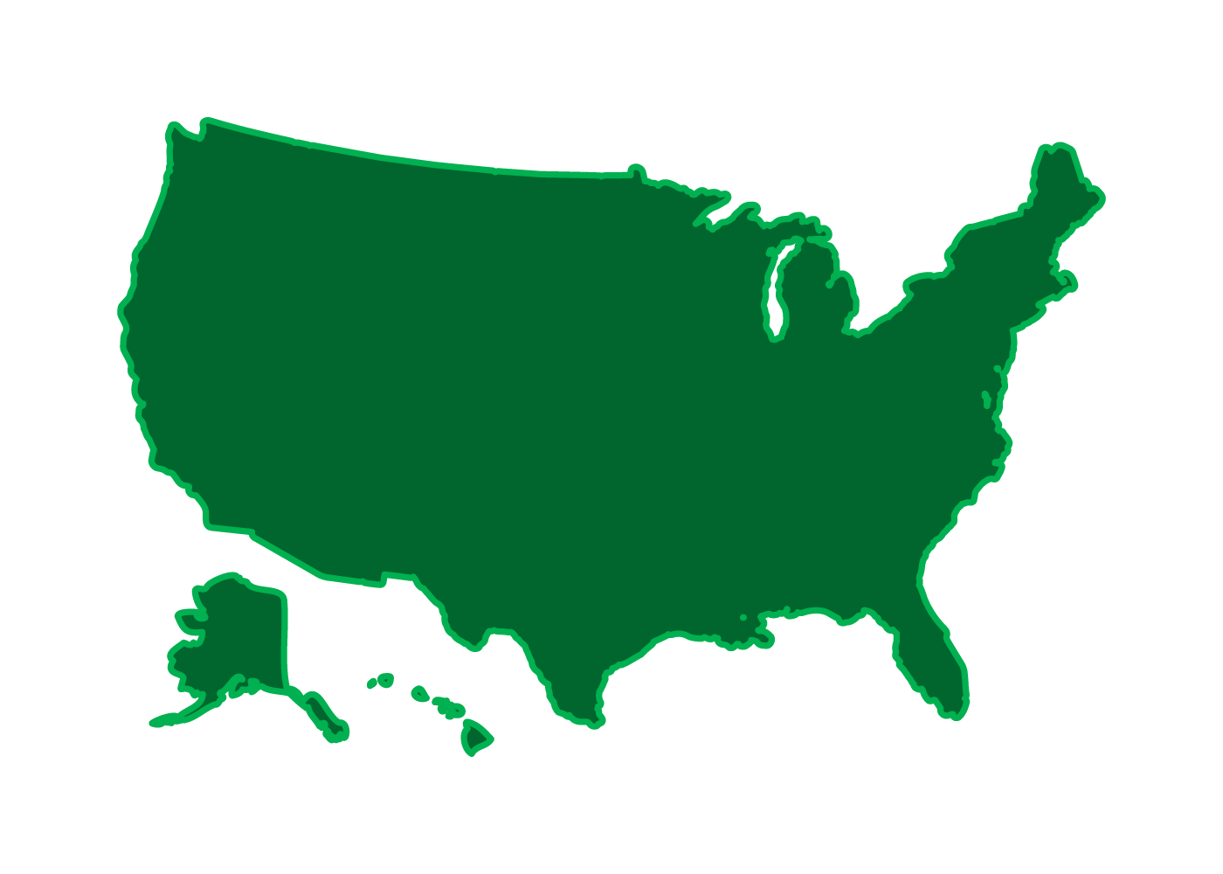
The pathway to Liftoff and scale for next-generation geothermal can proceed in two stages with increasing geographic reach
Reaching Liftoff
Achieving Scale
2-5 GW ($20-25B)
88-125 GW ($225-250B)
Prove and document
engineering capabilities
Unlock access to low-risk financing and larger capital pool
Mobilize new ecosystem of developers, investors, utilities, and other offtakers
Rapidly increase inventory of economic resources
Reduce cost with iterative improvements and implementation of new RD&D
Industrialize repeatable development process, leveraging existing oil & gas workforce and supply chain
Today
2030
2040
2050
1. Prove market opportunity
Deployments covering 5-10 different geologic settings
2. Expand viability of geothermal resources in competitive regions
Order and deliver projects, capitalizing on existing workforce and supply chain in competitive regions
3. Expand geothermal footprint to entire United States
Order and deliver projects across
entire United States
Pursue breakthrough RD&D Advances in drilling techniques and resource identification reduce costs and increase deployments
Notes:
CHARLES
This slide sketches out next-generation geothermal’s pathway to commercial liftoff and scale that we developed based on industry engagement and internal modeling.
The pathway has two stages, happening against a backdrop of R&D.
In the first stage, to reach liftoff, the industry needs to prove the market opportunity by demonstrating that next-generation geothermal can be reliably deployed in greenfield settings. This will unlock access to low-risk financing earlier in project development and a larger capital pool to take advantage of the large new market.
In the second stage, to reach full scale, the industry has to first expand viability of geothermal resources in the competitive regions of the American west, by ordering and delivering on projects. And then, as a new ecosystem of developers, investors, and offtakers matures and known resources snowball, the industry can expand to cover much of the united states.

Slide 18

Four key enablers can help next-generation geothermal achieve Liftoff conditions
Liftoff Conditions
5 - 10
2 - 5GW
$20 - 25B
geologic conditions
deployment
investment
Validation suite of deployments to prove low enough risk for debt during construction
4-6 States with multiple in-state deployments
Total next-generation geothermal deployment to cover sufficient geological conditions
1,300-3,300 wells drilled at ~3 MW/well
Total capital expenditure required for deployment
~60% cost reduction from 2023 estimate
Key Enablers
Cost reductions
Large-scale
demonstrations
High-value
PPAs
Community-informed siting
Cost reduced to $60-70/MWh National average LCOE ($40-50 in competitive regions)
30+MW scale demonstration projects
Prices that reflect clean firm value proposition
Site selection and development in partnership with communities
Data supporting repeatably consistent and maintained power production proves down technology risk
Offtake agreements with utilities or off-grid demand sources (e.g., industrial users or data centers) supports new projects
Leveraging tools to locate and co-develop next-generation geothermal developments with environmental justice and benefits in mind and in partnership with communities
Iterative cost improvements and the impact of directed R&D drive competitiveness in key early regions
Notes:
CHARLES
We spend some time in the report on the specific conditions and key enablers to hit liftoff by 2030, which is necessary to keep this industry on track to scale by 2050.
For liftoff, the key condition is what we’re calling a “validation suite” of deployments in 5-10 new geologic conditions, to prove that the tech is low enough risk for debt financing in greenfield sites. There is a risk that only acreage with known geothermal resources get developed, which would not accomplish this goal. Our modeling suggests this can happen with 2-5 GW of overall deployment, and $20-25B in investment.
To achieve these conditions, we see 4 key enablers: Continued cost reductions on pace to the Earthshot target. Large-scale demonstrations in new locations. Offtake with prices that truly reflect the value of clean firm power, and community partnership on project, technological, and regulatory developments .

Slide 19
A fully mature geothermal industry could develop projects using project finance
Developer classes, investment sources, and development models available at different levels of industry maturity
FOAK
NOAK
Industry Maturity
Risks | Technology Resource | Technology Resource | Technology Resource
Appropriate developer class | Early stage (e.g., start-ups; internal innovation teams) | Maturing early-stage entities Upstream oil & gas; mining | Established renewables developers Upstream oil & gas; mining
Potential sources of investment | Corporate equity (early-stage) Philanthropy and public grants Strategic investor-offtakers | Corporate equity Private equity High-cost debt Strategic investor-offtakers | Infrastructure investors Corporate equity Project equity Low-cost debt
Project stage at debt entry | n/a | Surface construction | Subsurface development (after first well)
Development model Up-front equity¹ (hurdle rate) | Unlevered equity ~$450M (loss leader) | High-risk financing strategies ~$180M (20+%) | Low-risk financing strategies ~$5-10M (5-10%)
High
Medium
Low
Demonstration Projects
“Farm-Down”
Project Finance
Notes: 1. Estimate of necessary equity required before first access to debt for a 30MW next-generation geothermal plant

Slide 20
Chapter 4: Challenges & Opportunities
Community opposition in some instances
Adherence to long-established induced seismicity and environmental monitoring best practices
Early, frequent, and transparent community engagement
High up-front costs & risks constraining development capital and limiting geographic reach.
About $5 billion out of the $20-25 billion of capital formation in the liftoff phase to finance the validation suite of first-of-a-kind (FOAK) developments in varied geologies, sourced from governments, equity investments, corporate venture or strategic investor-offtakers, or oil & gas
Market signals, such as high-valued PPAs, to motivate investment in initial loss-leaders
In-field testing and innovation at active geothermal developments through RD&D spending
New financial products to reduce drilling costs, such as public/private cost-share agreements and drilling insurance programs
Perceived & actual operability risk for deployments constraining demand and investor appetite
Strategic demonstration siting and data dissemination from 10+ early deployments to show sustained power production
Long and unpredictable development lifecycles driven by permitting and interconnection
Allowing for combining and streamlining of specific steps in permitting process, where authorized.
Technology changes that allow certain steps to occur in tandem
Continued and increased support for permitting agency capacity, where authorized.
Existing business models undervaluing the potential of next-generation geothermal
Planning policies that incentivize higher-cost, higher-value power
Leverage flexible geothermal operations to capture highest-value power
New offtake models, e.g. subsurface developers providing heat for multiple purposes

Slide 21
Chapter 4: Challenges & Opportunities
High up-front costs & risks constraining development capital and limiting geographic reach.
About $5 billion out of the $20-25 billion of capital formation in the liftoff phase to finance the validation suite of first-of-a-kind (FOAK) developments in varied geologies, sourced from governments, equity investments, corporate venture or strategic investor-offtakers, or oil & gas
Market signals, such as high-valued PPAs, to motivate investment in initial loss-leaders
In-field testing and innovation at active geothermal developments through RD&D spending
New financial products to reduce drilling costs, such as public/private cost-share agreements and drilling insurance programs
Funding allocated for large-scale demonstrations, manufacturing and supply chains, and supportive infrastructure
Bipartisan Infrastructure Law and Inflation Reduction Act

Slide 22
Chapter 4: Challenges & Opportunities
Perceived & actual operability risk for deployments constraining demand and investor appetite
Strategic demonstration siting and data dissemination from 10+ early deployments to show sustained power production

Slide 23
Chapter 4: Challenges & Opportunities
Long and unpredictable development lifecycles driven by permitting and interconnection
Allowing for combining and streamlining of specific steps in permitting process, where authorized.
Technology changes that allow certain steps to occur in tandem
Continued and increased support for permitting agency capacity, where authorized.
Lease sale
Resource confirmation
Interconnection
Categorical exclusion: Exploration
2-4 months
Exploration activities
2-4 months
Environmental assessment: Exploration drilling
6-12 months
Exploration drilling
6-12 months
Environmental assessment: Resource confirmation
1-1.5 years
Drill production and injection wells
1-1.5 years
Environmental assessment: Powerplant & transmission
1-1.5 years
Complete power plant, facilities, transmission lines
1-1.5 years
Current
process
Total project time: 7-10 years
Categorical exclusion: Exploration and drilling
2-4 months
Exploration activities and drilling
Environmental assessment: Resource confirmation, powerplant and transmission
1-1.5 years
Drill production and injection wells
1-1.5 years
Complete power plant, facilities, transmission lines
1-1.5 years
Total project time: 4-7 years
Potential reformed process
Project milestones
Permitting/licensing
Project construction
Reformed step
6-12 months
Lease sale
Resource confirmation
Interconnection

Slide 24
Chapter 4: Challenges & Opportunities
Existing business models undervaluing the potential of next-generation geothermal
Planning policies that incentivize higher-cost, higher-value power
Leverage flexible geothermal operations to capture highest-value power
New offtake models, e.g. subsurface developers providing heat for multiple purposes

Slide 25
Chapter 4: Challenges & Opportunities
Community opposition in some instances
Adherence to long-established induced seismicity and environmental monitoring best practices
Early, frequent, and transparent community engagement

Slide 26
Thank you!
We want to hear from you!
To help inform future Liftoffs, please submit feedback at:
liftoff.energy.gov/input

